Slide 1
great outdoors Group-b
By
C Akhil chowdary

Slide 2
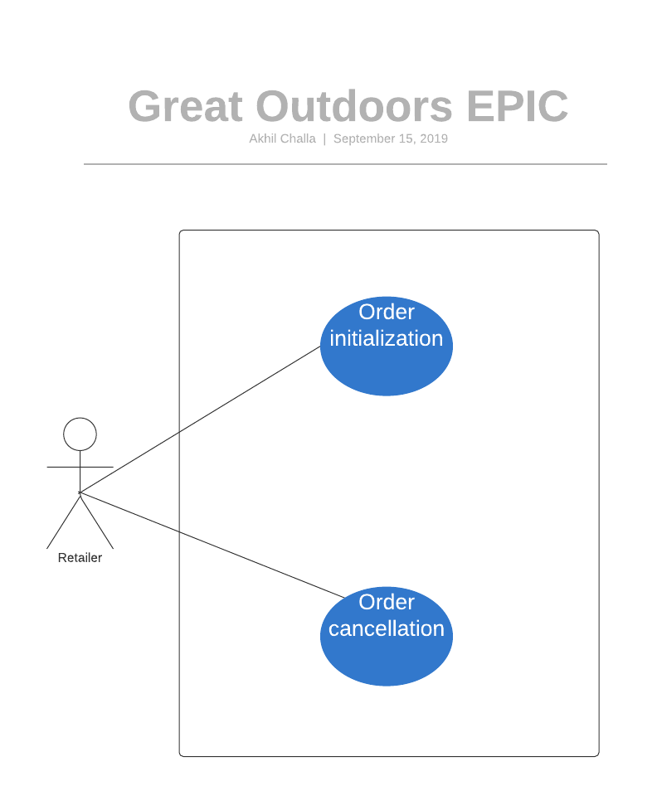
EPIC and user stories

Slide 3
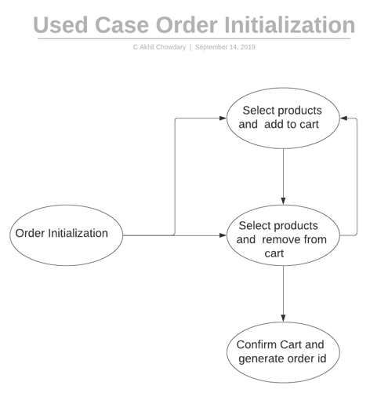
Used case 1: order initialization

Slide 4
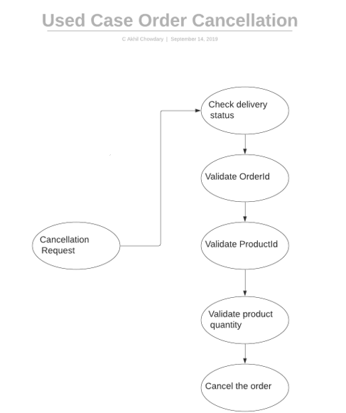
Used case 2: order cancellation

Slide 5
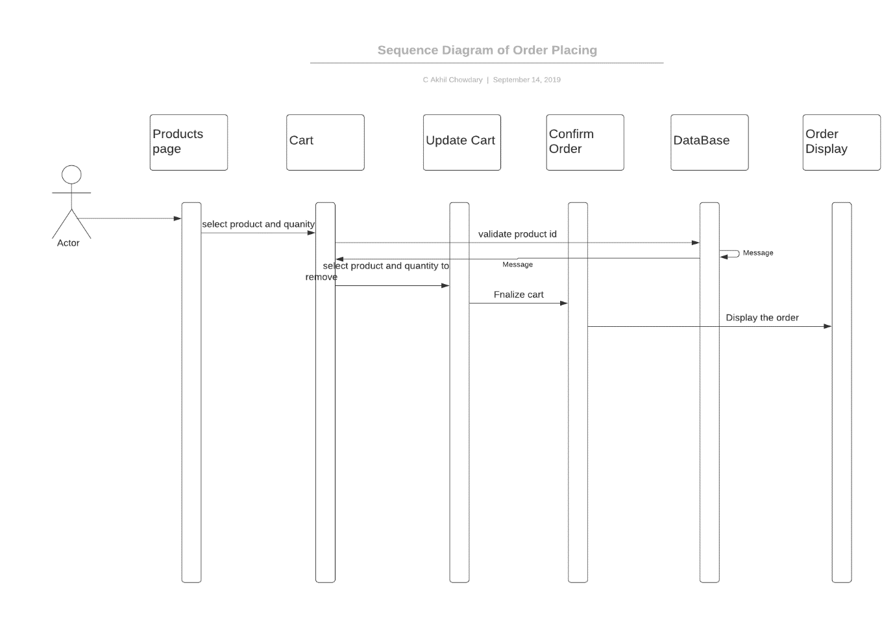
Sequence diagram: order initialization

Slide 6
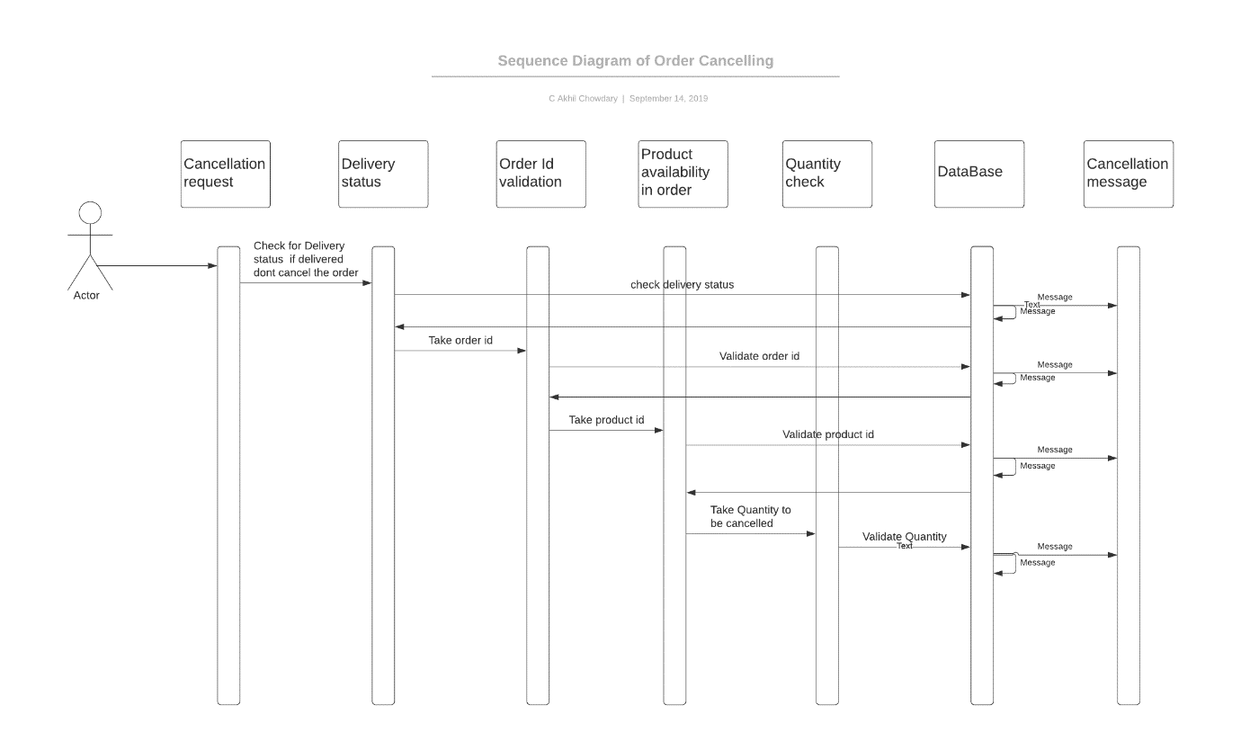
Sequence diagram: order cancellation

Slide 7
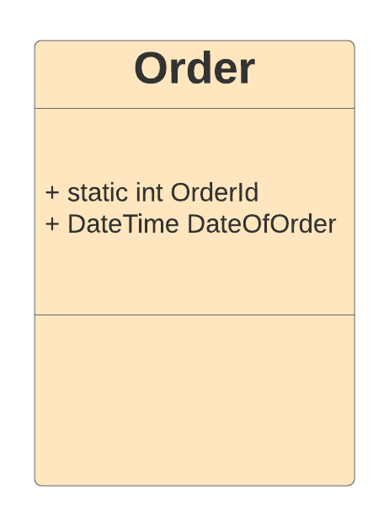
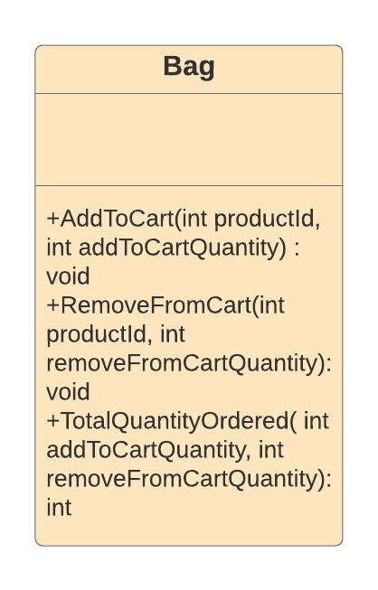
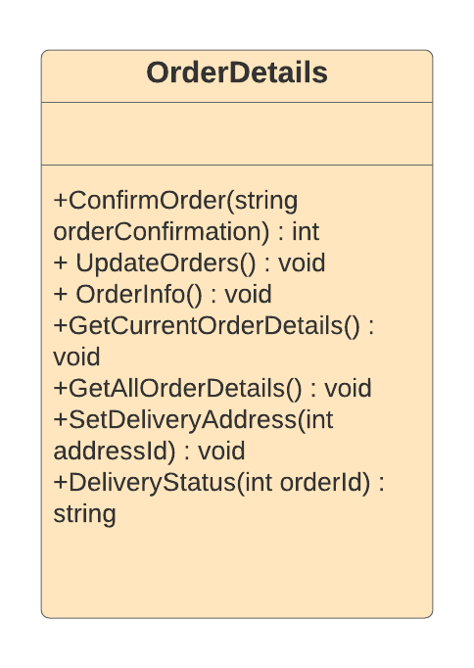
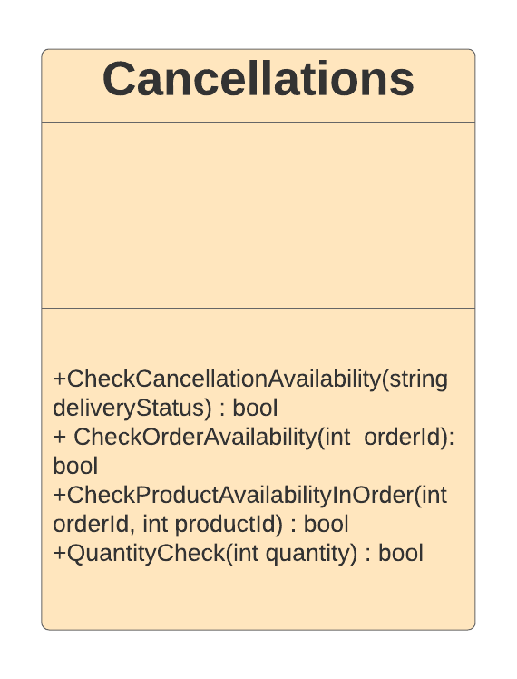
class diagram
GreatOutdoors.Entities:
GreatOutdoors.DataAccessLayer
GreatOutdoors.BusinessAccessLayer

